Slide 1

Vaccine Doses Administered Per County

Slide 2
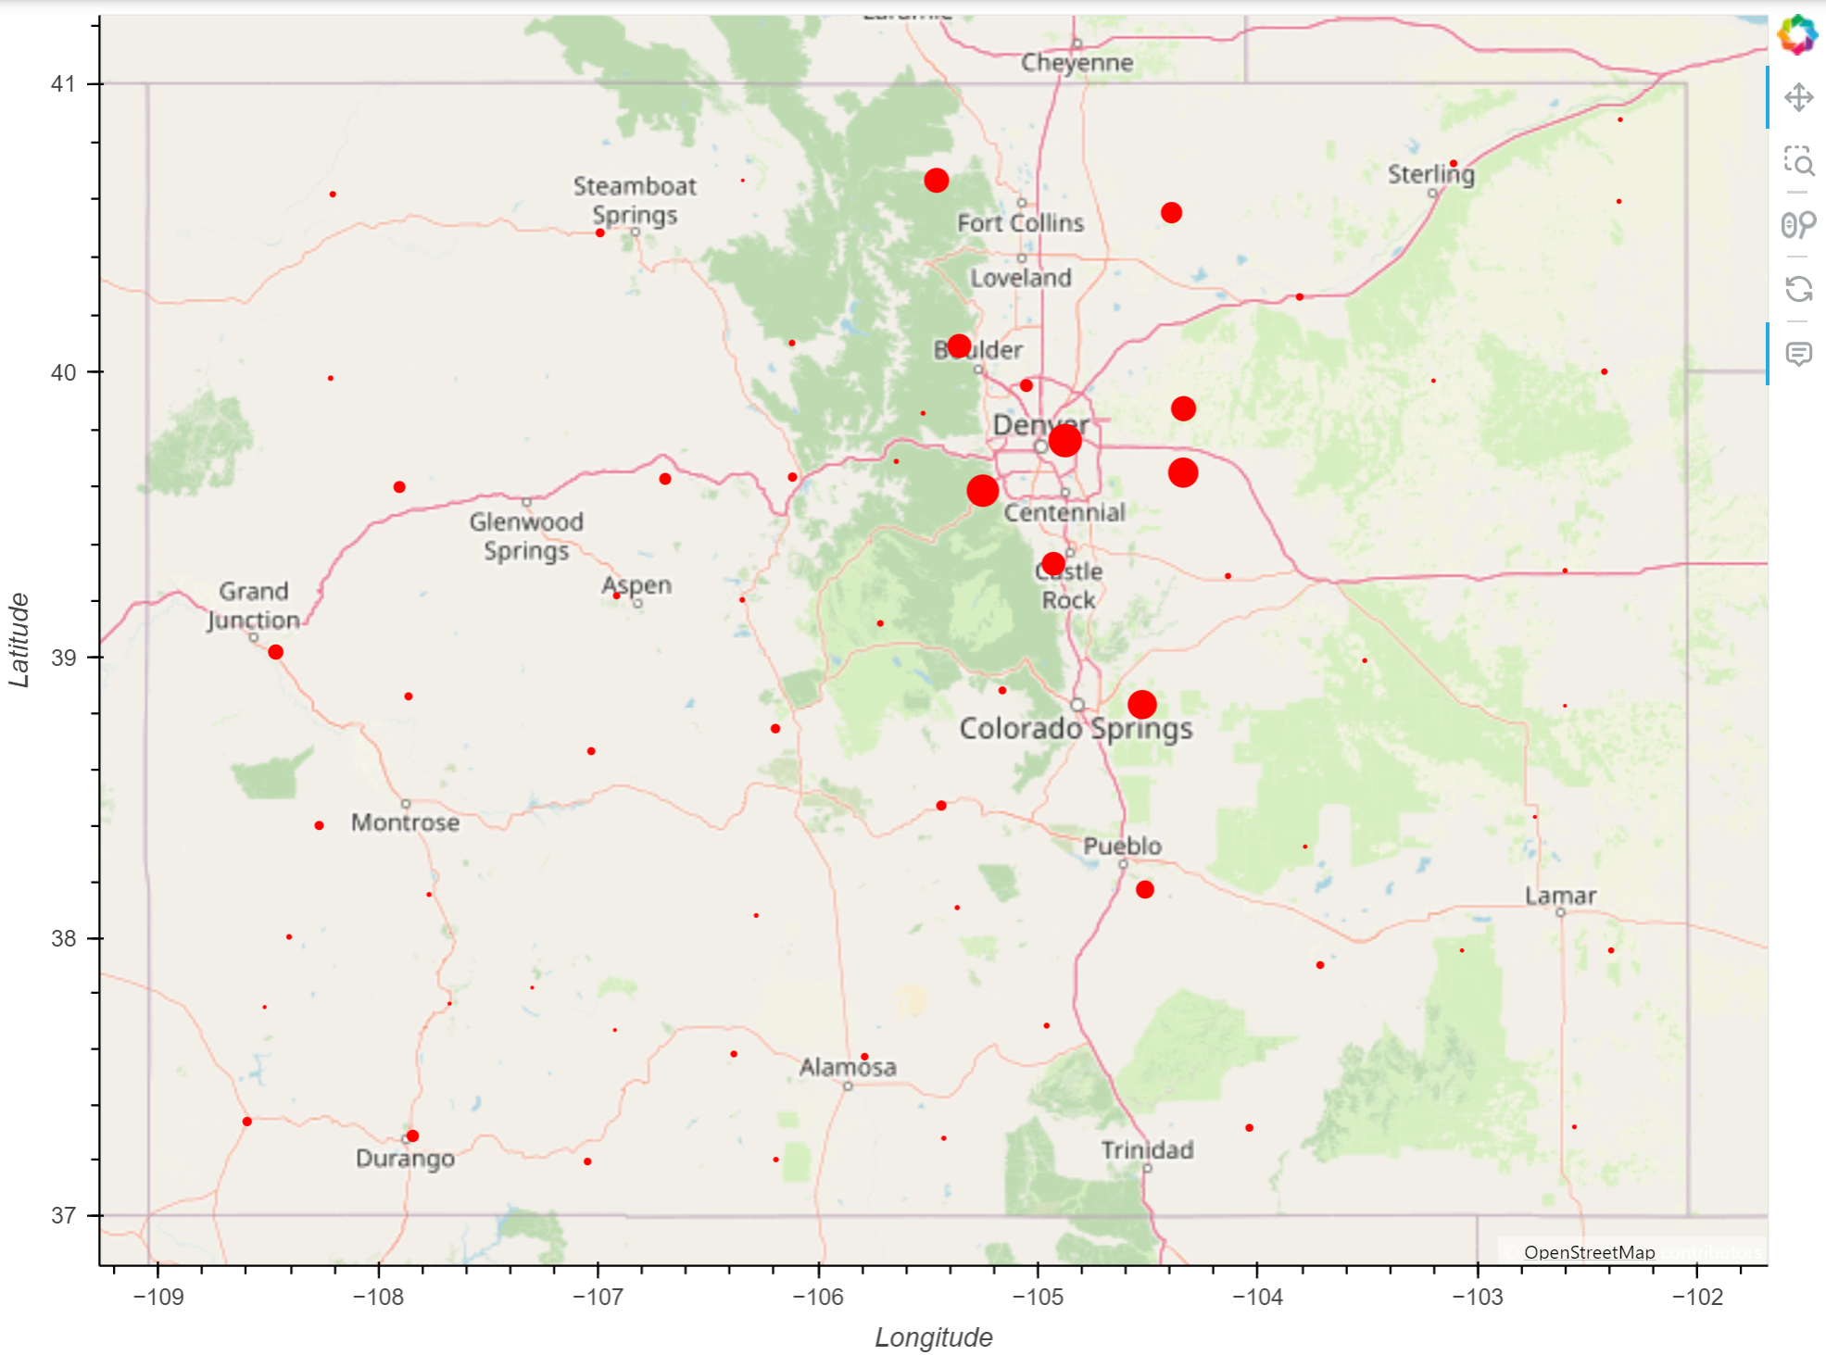
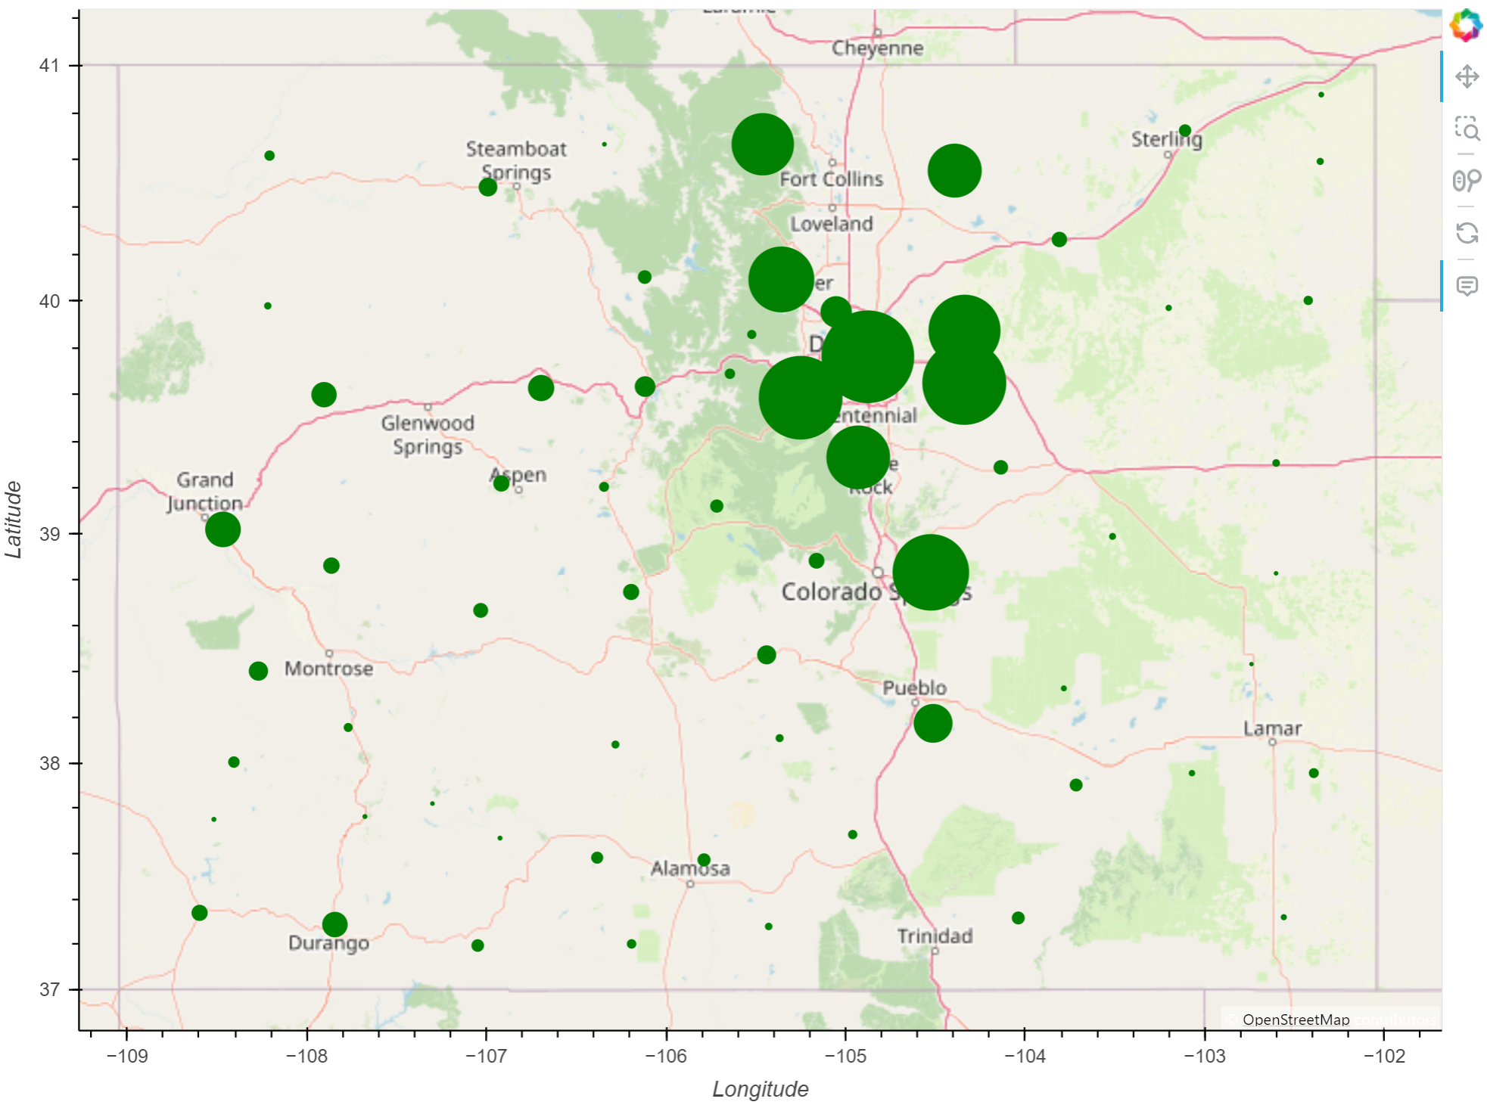
2020
2023
Notes:
Changes in doses administered per county
Smaller counties can barely even been seen in 2020
By 2023, ever dot is at least slightly visible.
Huge jump between 2020 and 2023 in doses administered

Slide 3
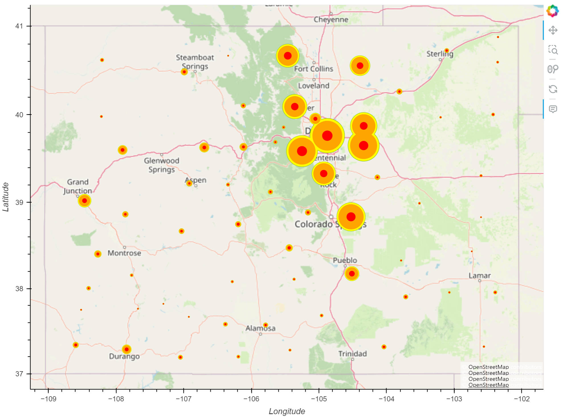
Notes:
Largest jump in vaccines administered between 2020 and 2021, slows down 2022 to 2023
Can barely even see the green behind the yellow

Slide 4
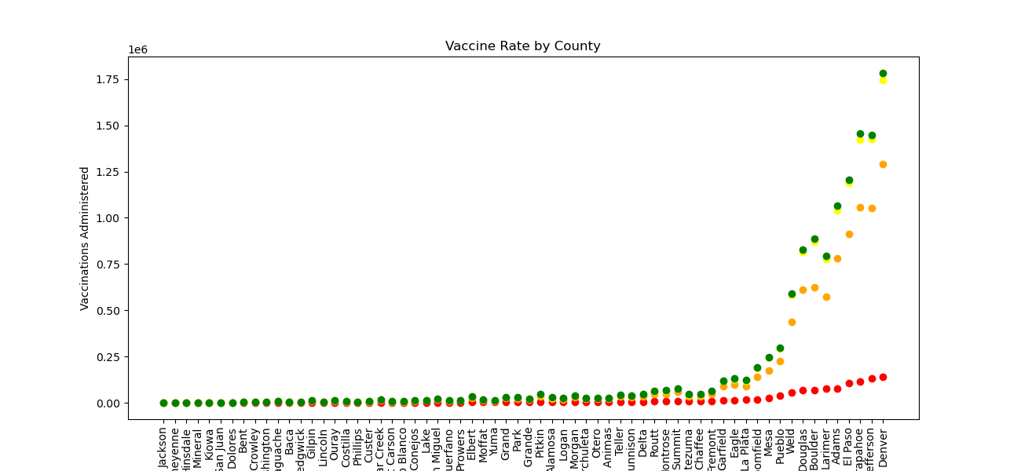
Notes:
Red is 2020, can see there isn’t much variance across the counties
2021, you can really see the jump larger counties take
Another large jump 2022
Very slight increase 2022 to 2023

Slide 5
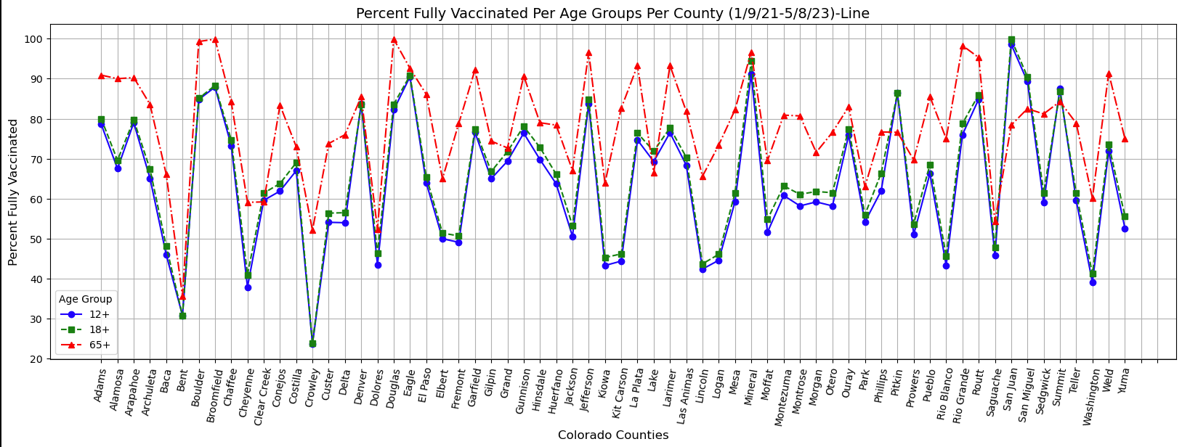
Vaccine Rate Per Age Group - Line
Notes:
Mineral vaccinate at almost an equal rate per age. While there were huge drops in 18+ for Crowley and Bent. Where less than half of those counties were vaccinated.

Slide 6
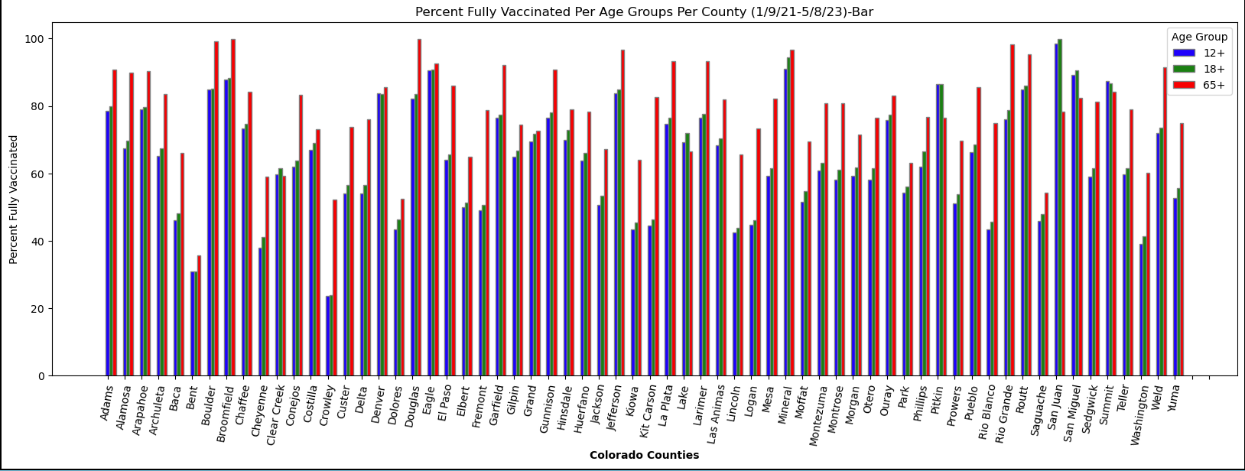
Vaccine Rates per Age Group - Bar

Slide 7

COVID-19 Vaccination Rates per Series

Slide 8
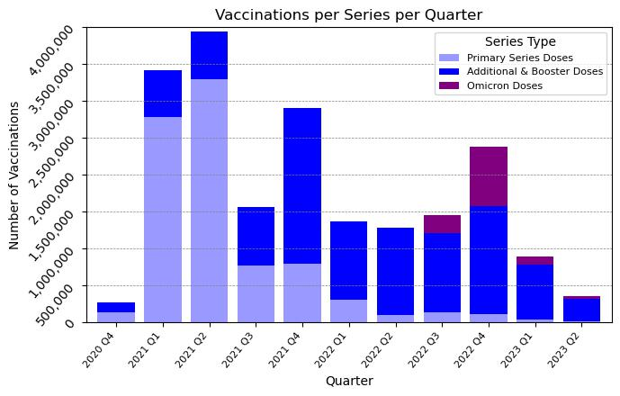
Volumes of Vaccination and Booster Series over Time
The dataset indicates some expected results for the rollout of vaccinations and boosters.
Observable spikes are seen upon first vaccine availability, based on the initial rollouts, subsequent variant, booster recommendations, and Omicron specific vaccinations.

Slide 9
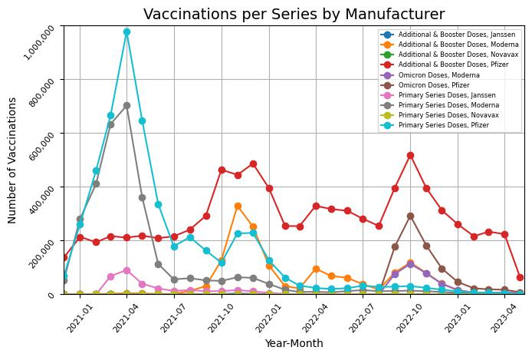
Volumes of Vaccination and Booster Series over Time
A discrepancy appears in the dataset from CDPHE when reviewing the manufacturer of boosters administered at the time Omicron vaccinations became available in Q3 2022.
Volume of Omicron vs. Additional & Booster doses appears to represent a possible mis-identification either at the point of vaccination or point of data referral to CDPHE on the type/series provided.

Slide 10
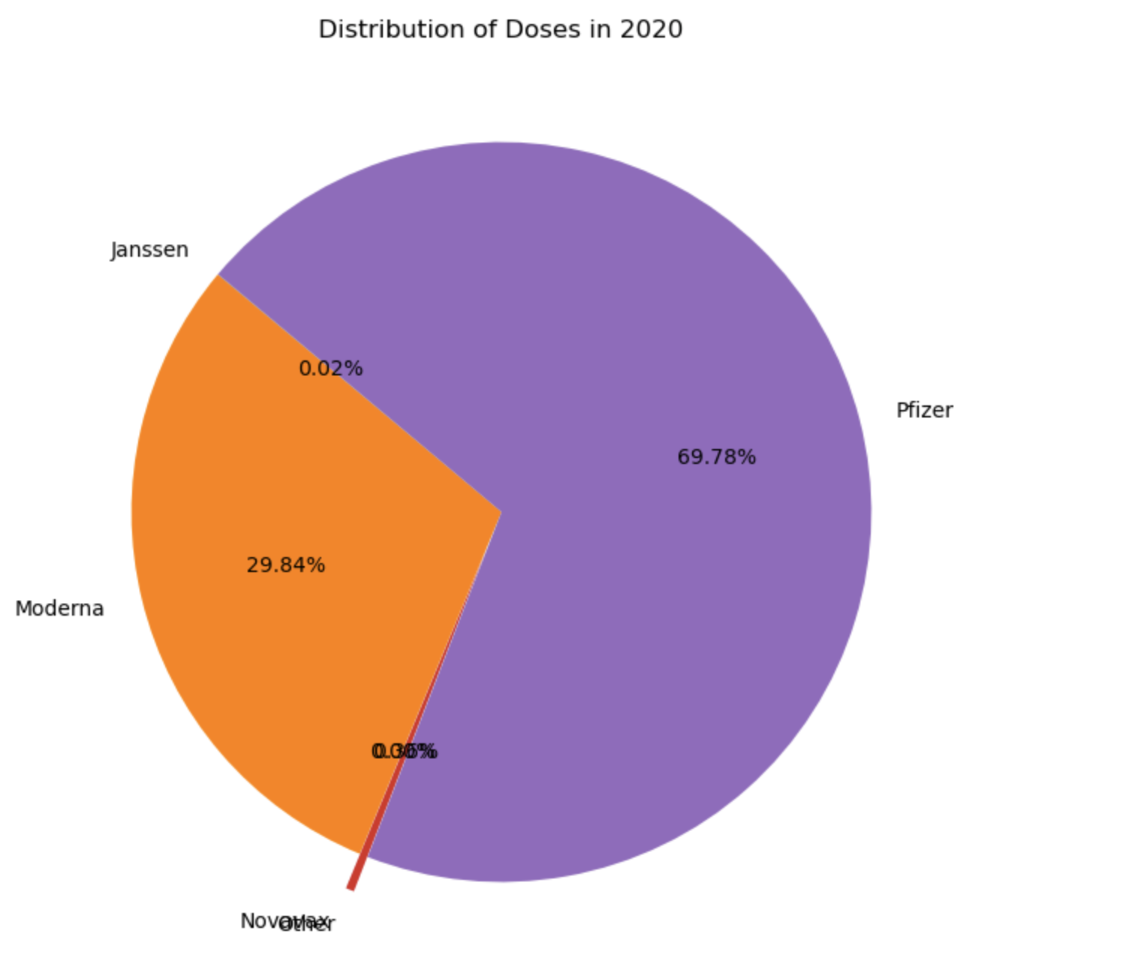
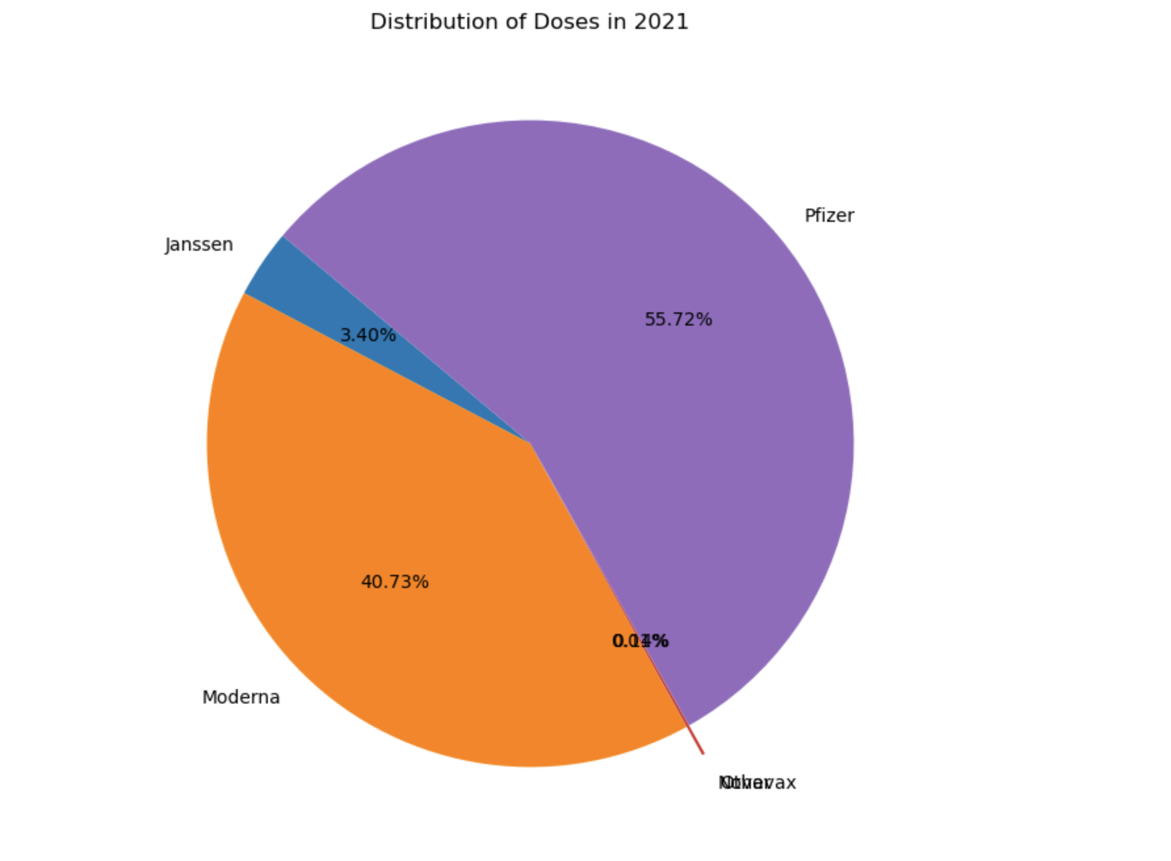
Vaccine Distribution By Year

Slide 11
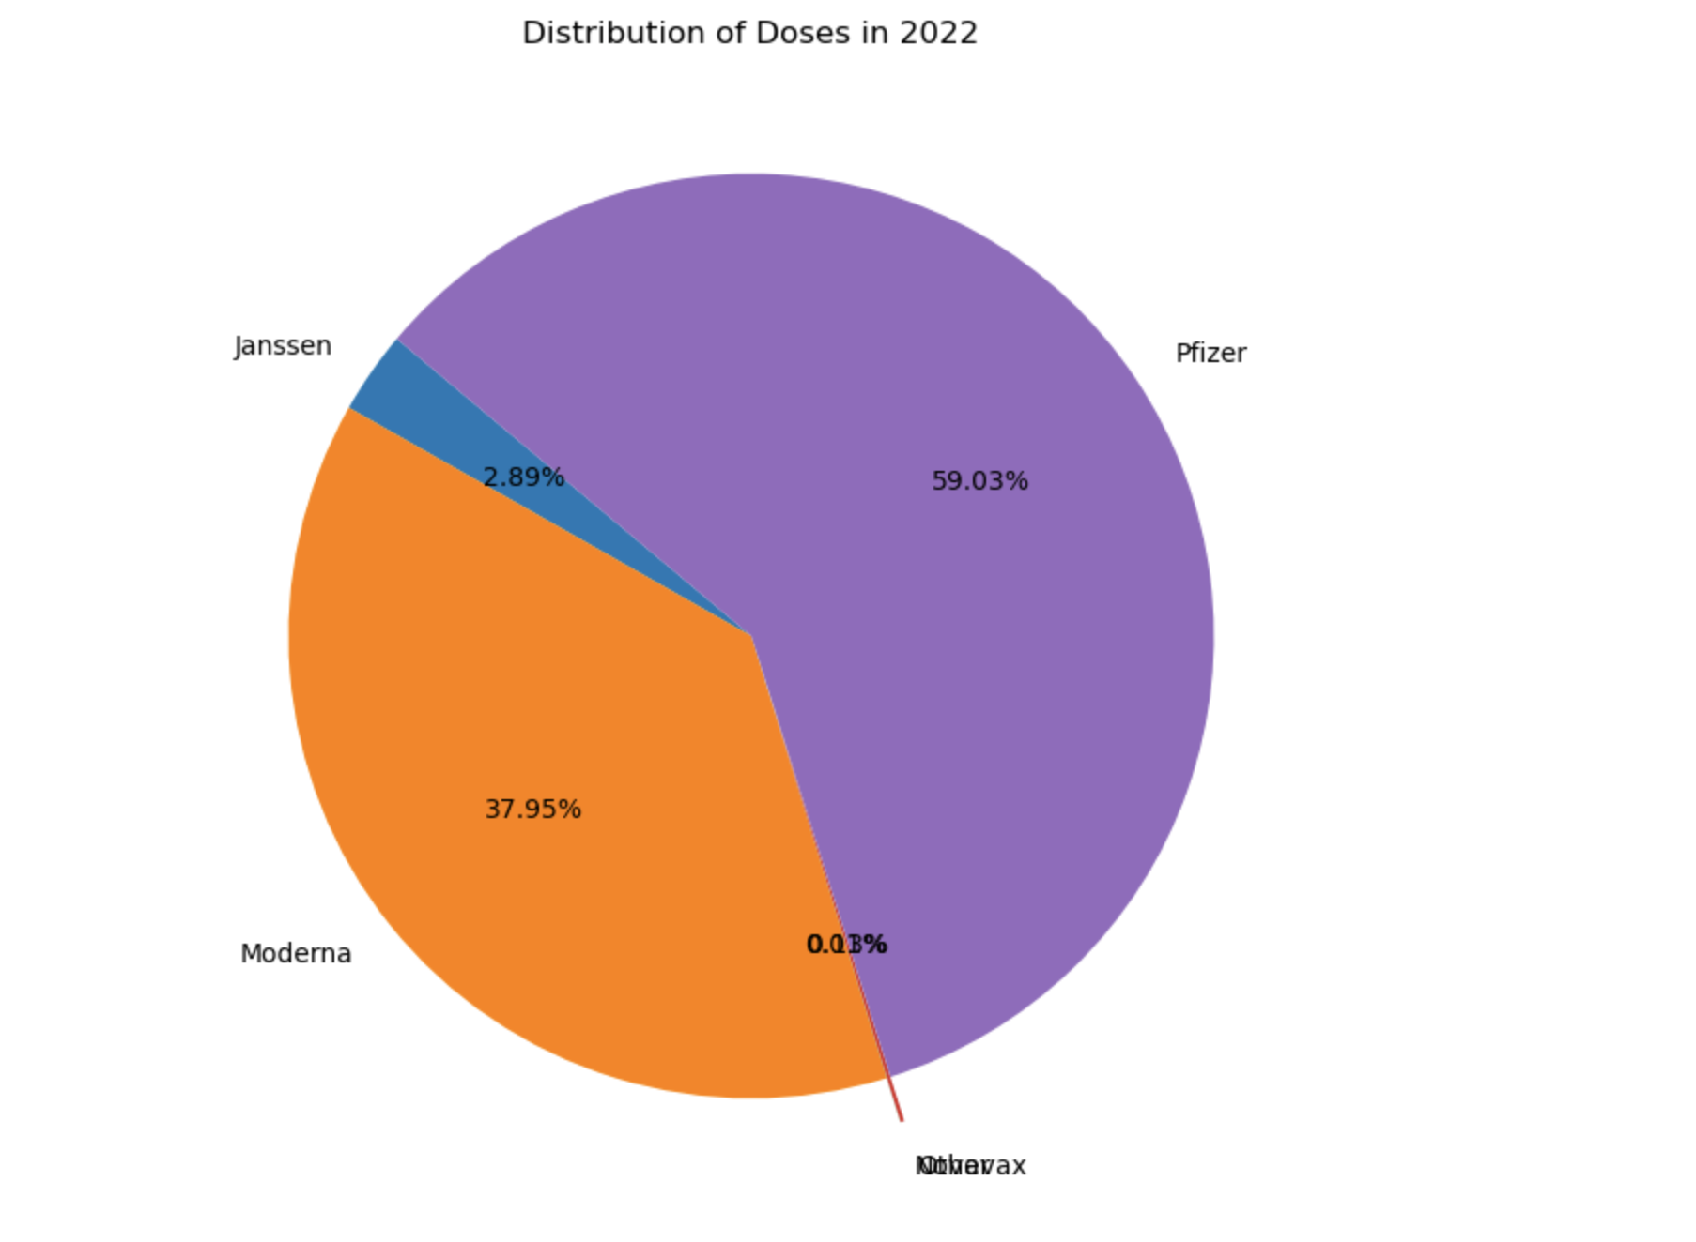
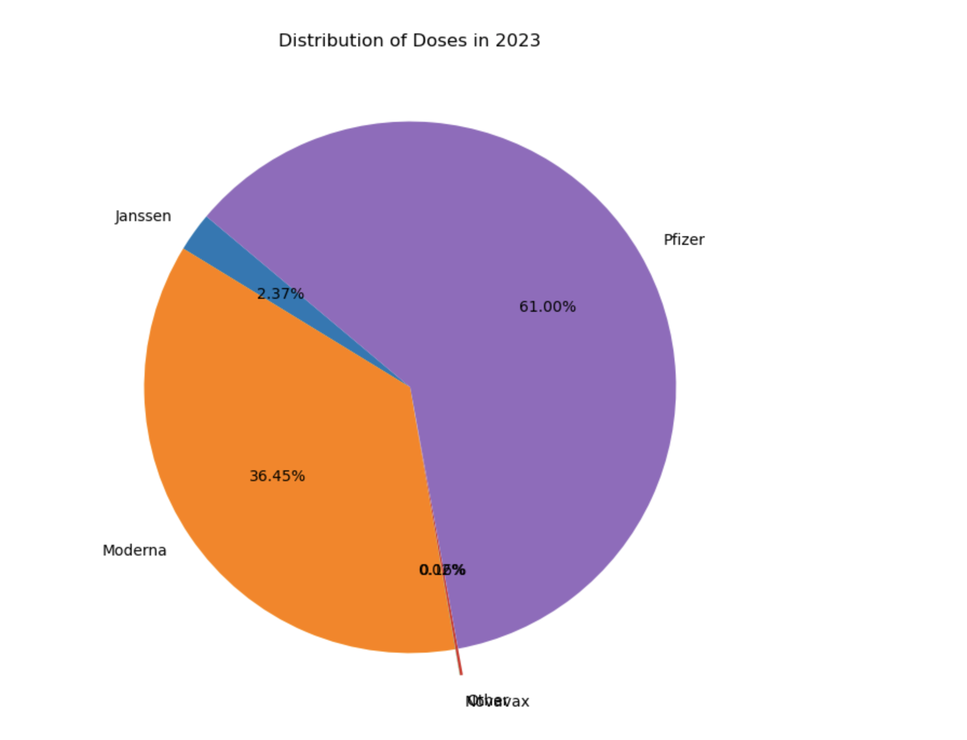

Slide 12
